Slide 1
Introduction to Kotlin Programming
David Drohan (ddrohan@wit.ie)

Slide 2

Introducing Kotlin
Overview - Part 3

Slide 3
Agenda
What is Kotlin?
Context - Java Vs JVM
Kotlin History
Milestones
General Overview & Features
Kotlin & IntelliJ IDEA
Conclusion

Slide 4
Agenda
What is Kotlin?
Context - Java Vs JVM
Kotlin History
Milestones
General Overview & Features
Kotlin & IntelliJ IDEA
Conclusion

Slide 5


Slide 6
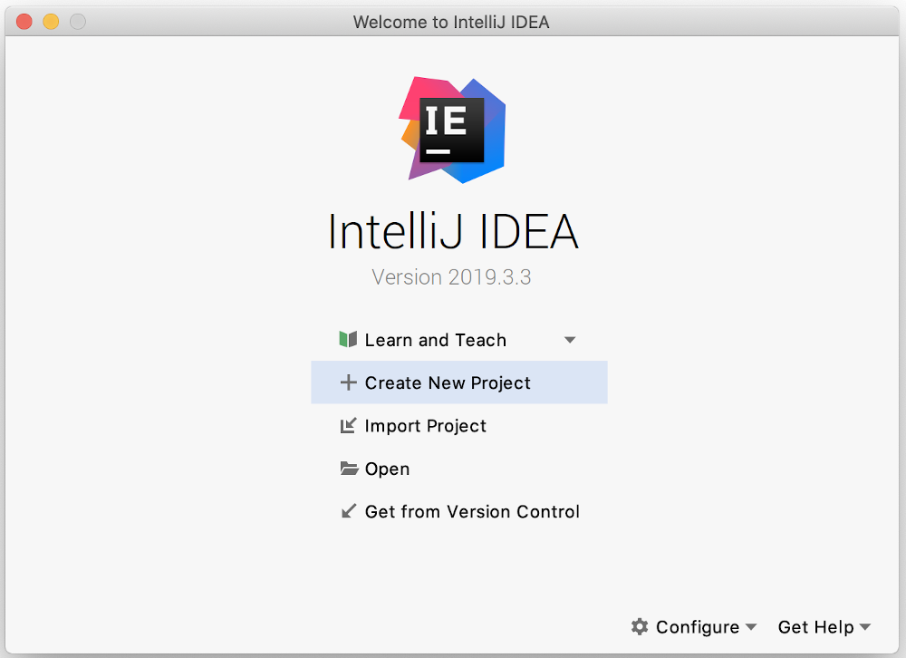
New Project using IntelliJ

Slide 7
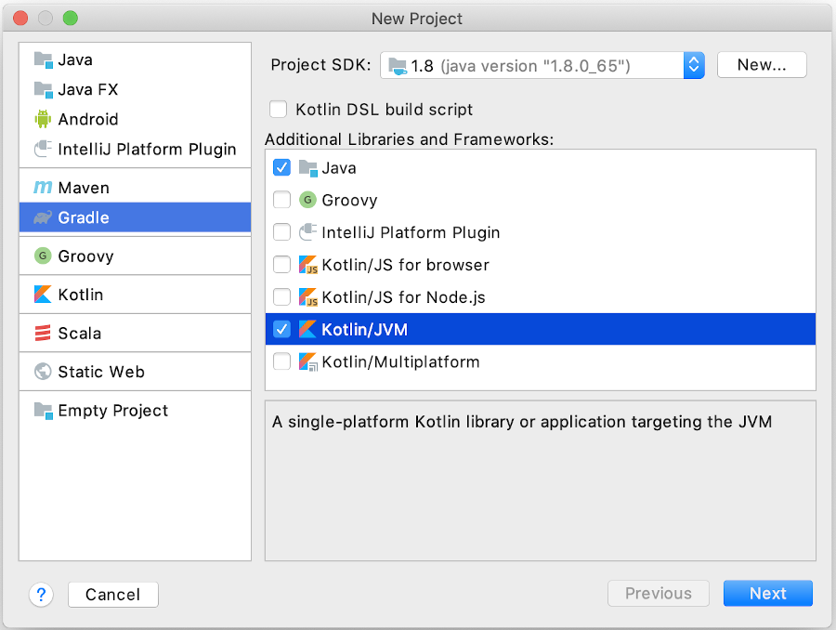
New Project using IntelliJ

Slide 8
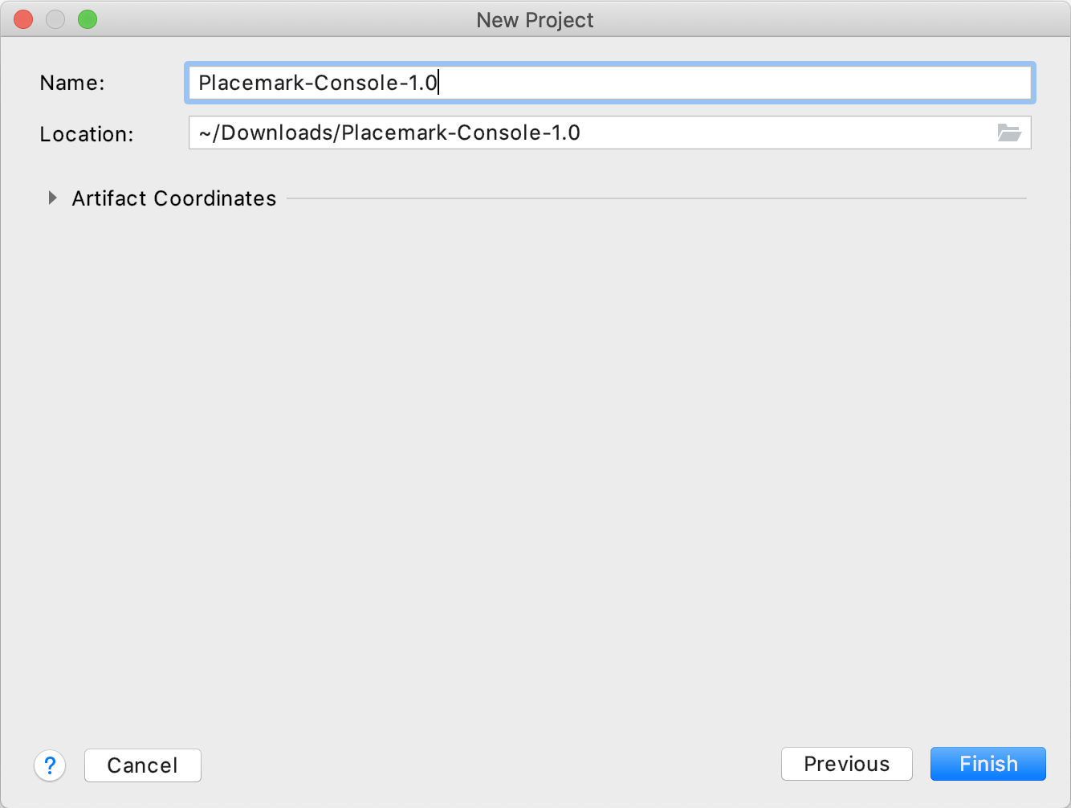
New Project using IntelliJ

Slide 9
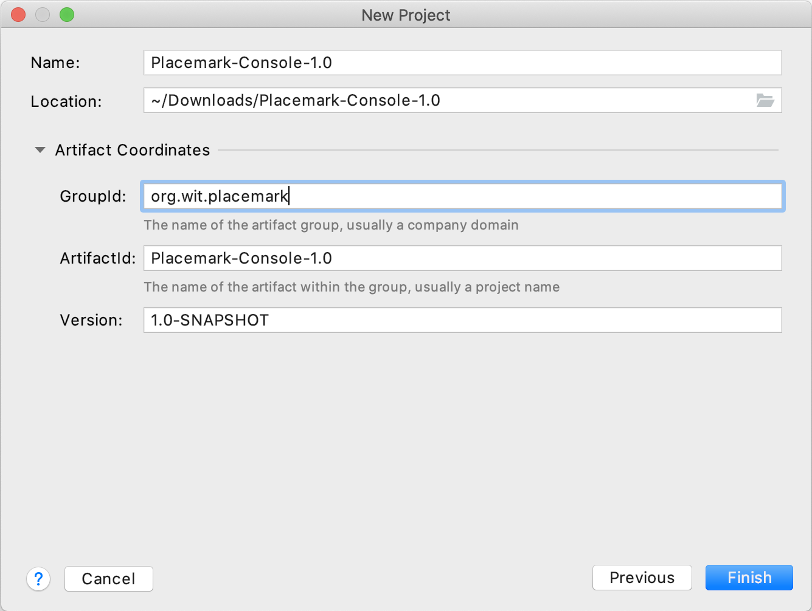
New Project using IntelliJ

Slide 10
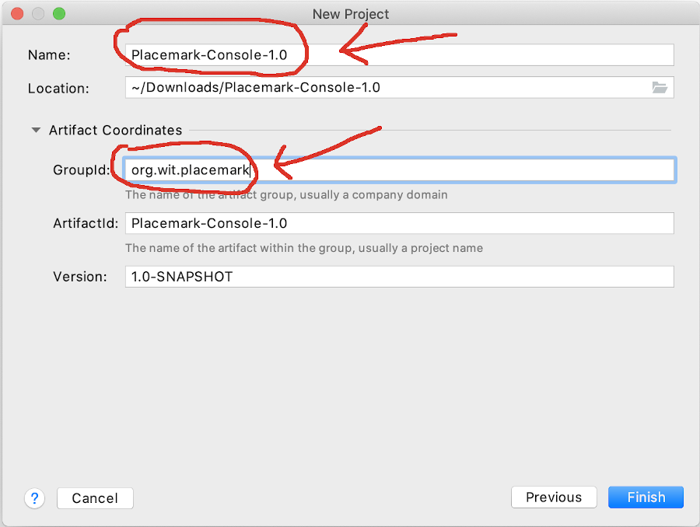
New Project using IntelliJ

Slide 11
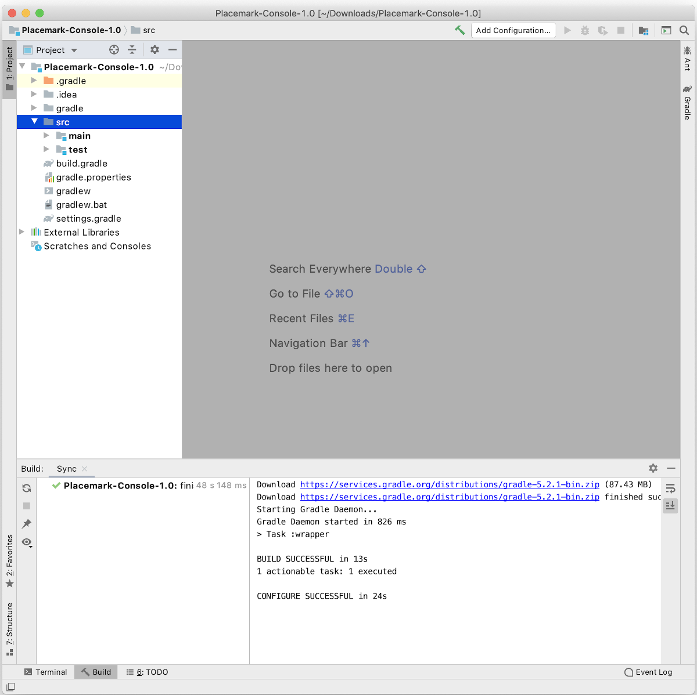
New Project using IntelliJ

Slide 12
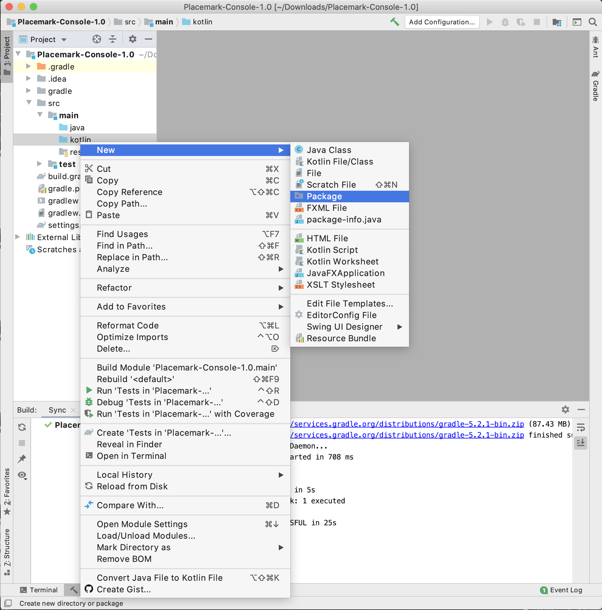
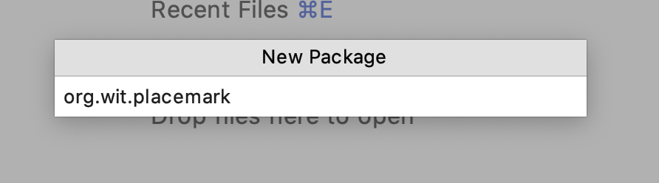
New Project using IntelliJ

Slide 13
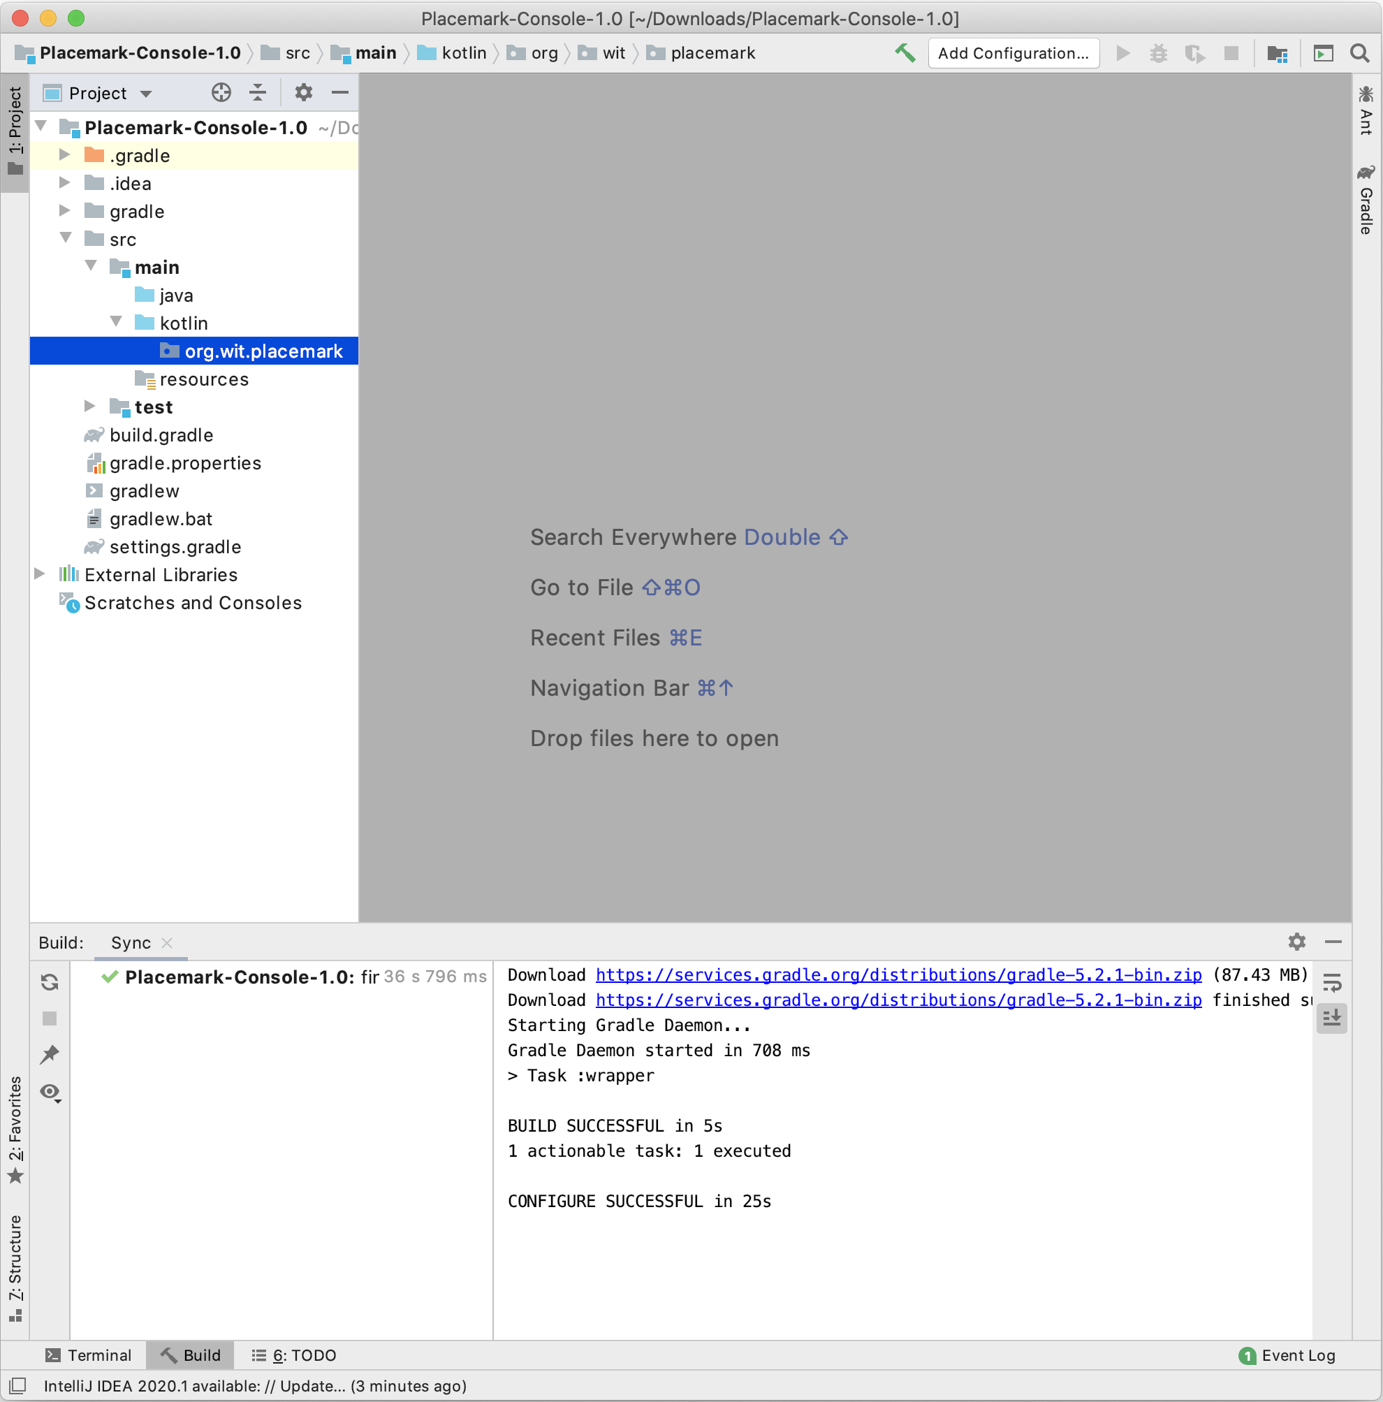
New Project using IntelliJ

Slide 14
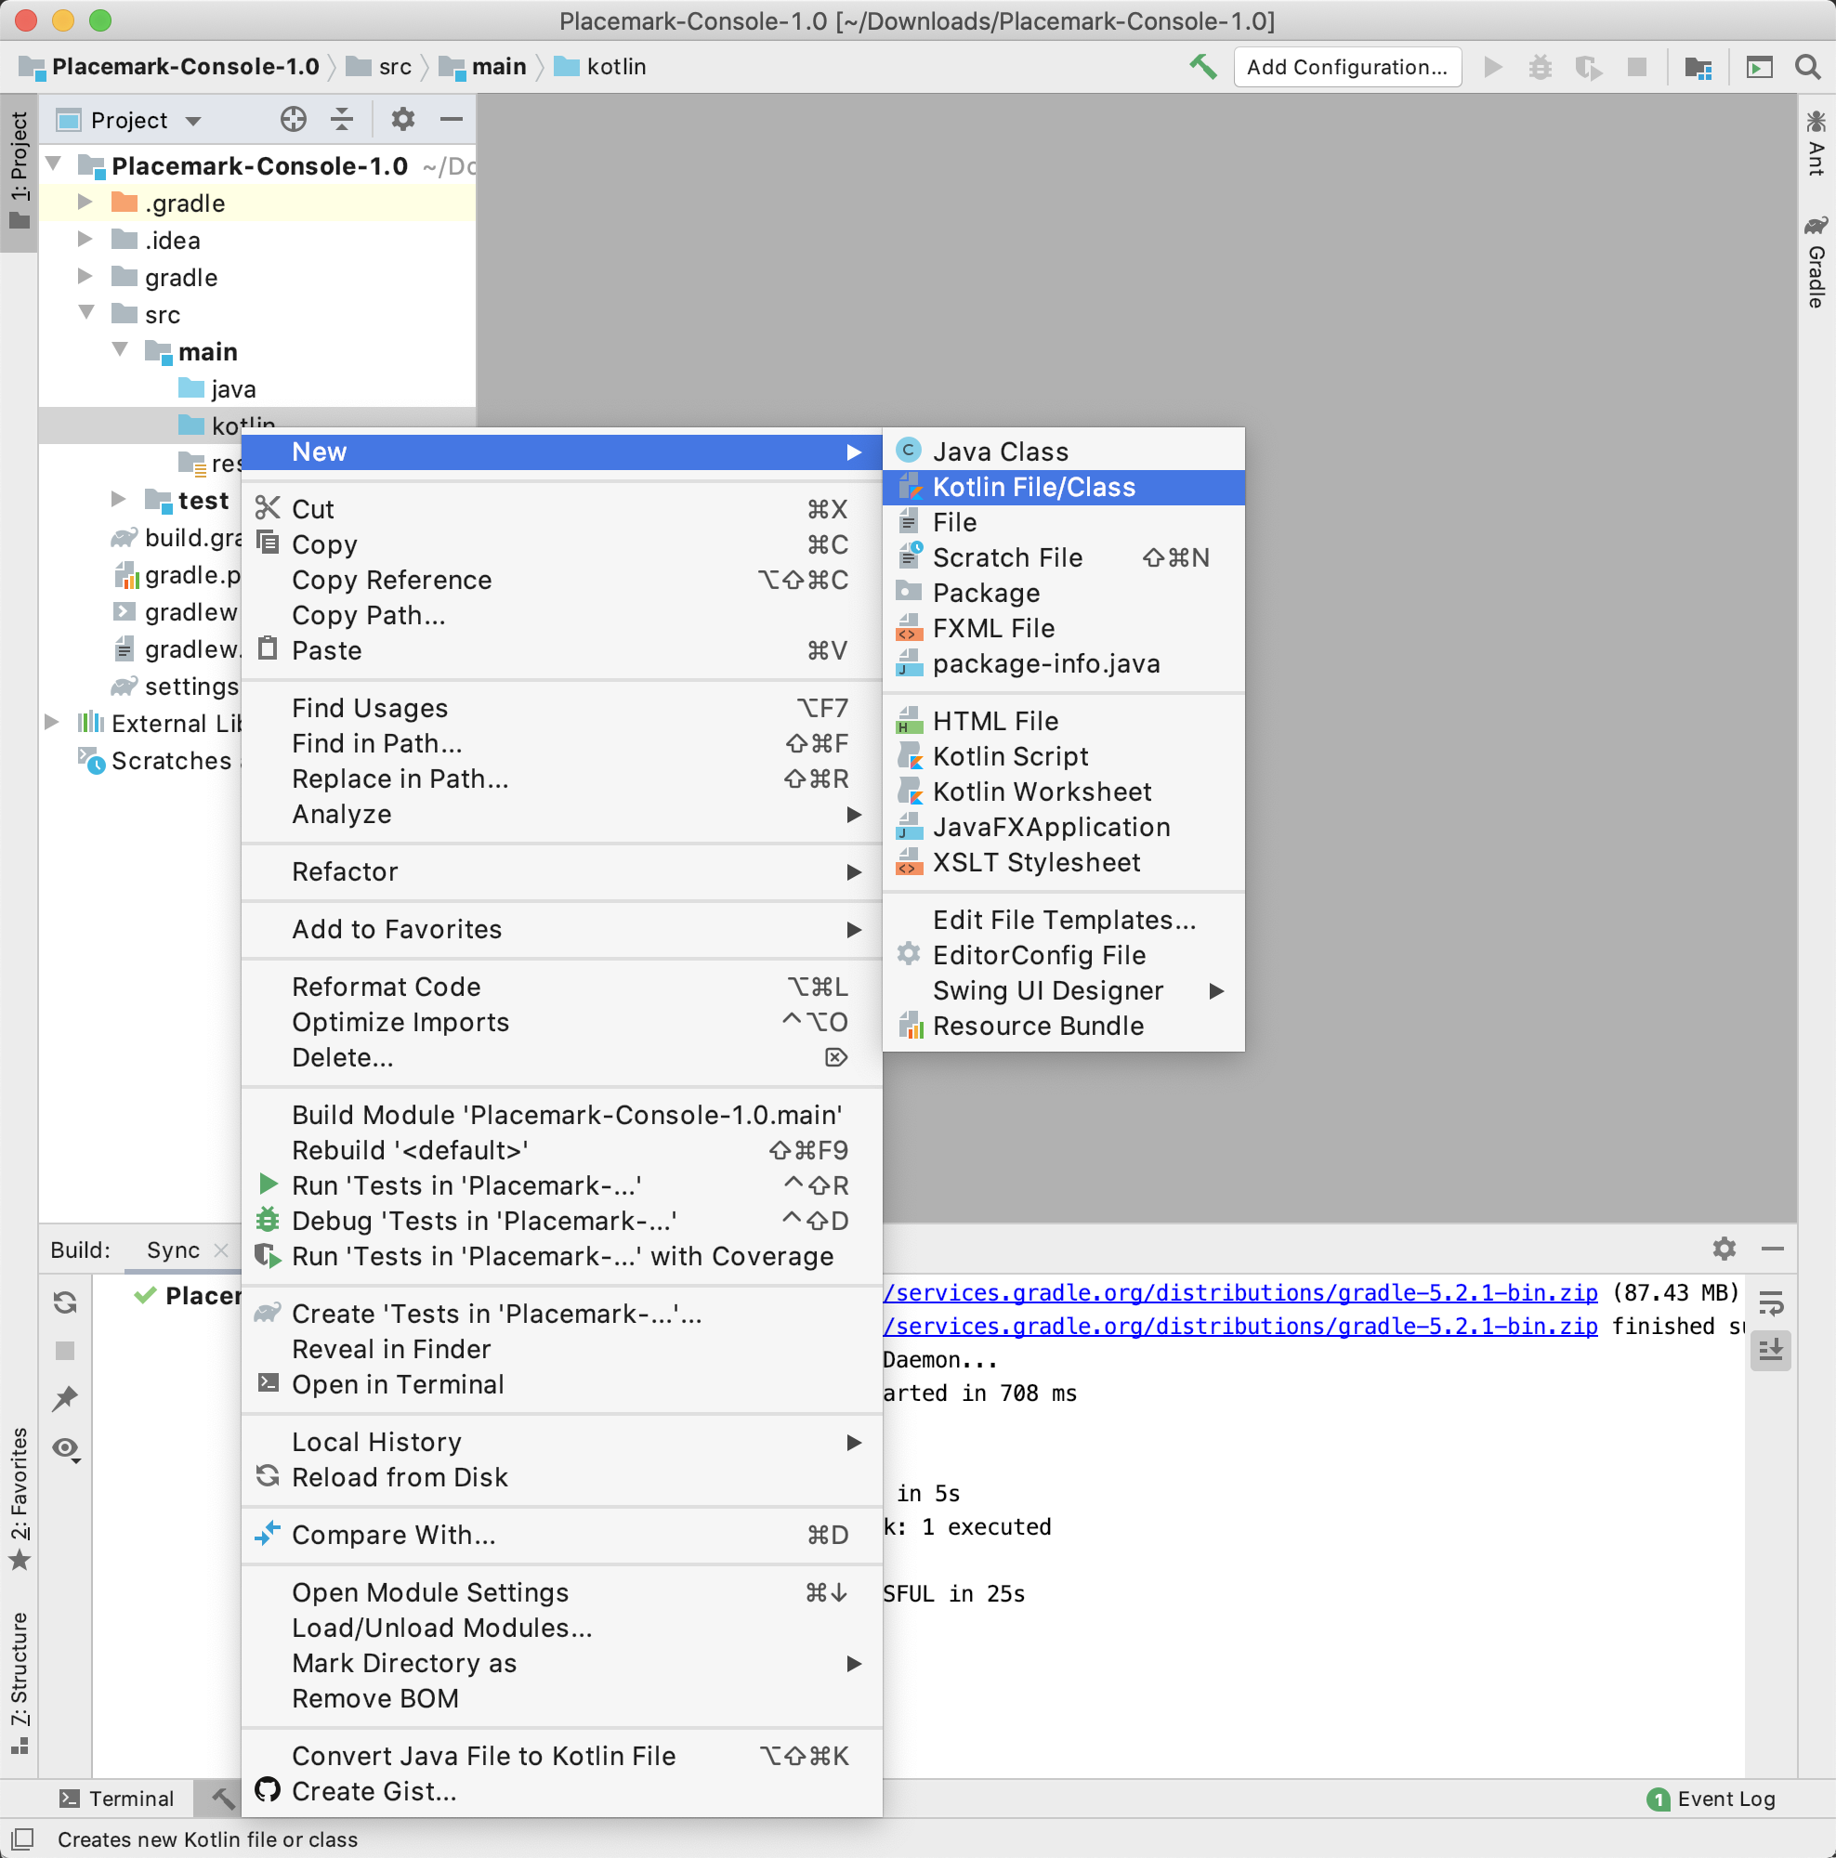
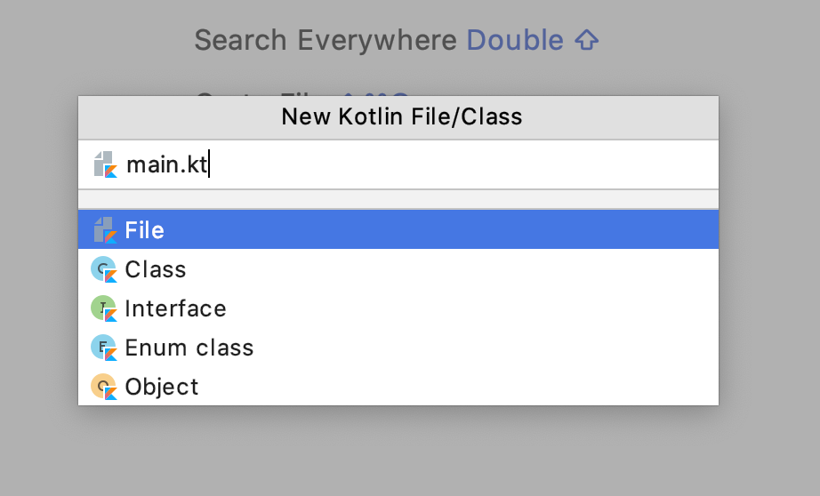
New Project using IntelliJ

Slide 15
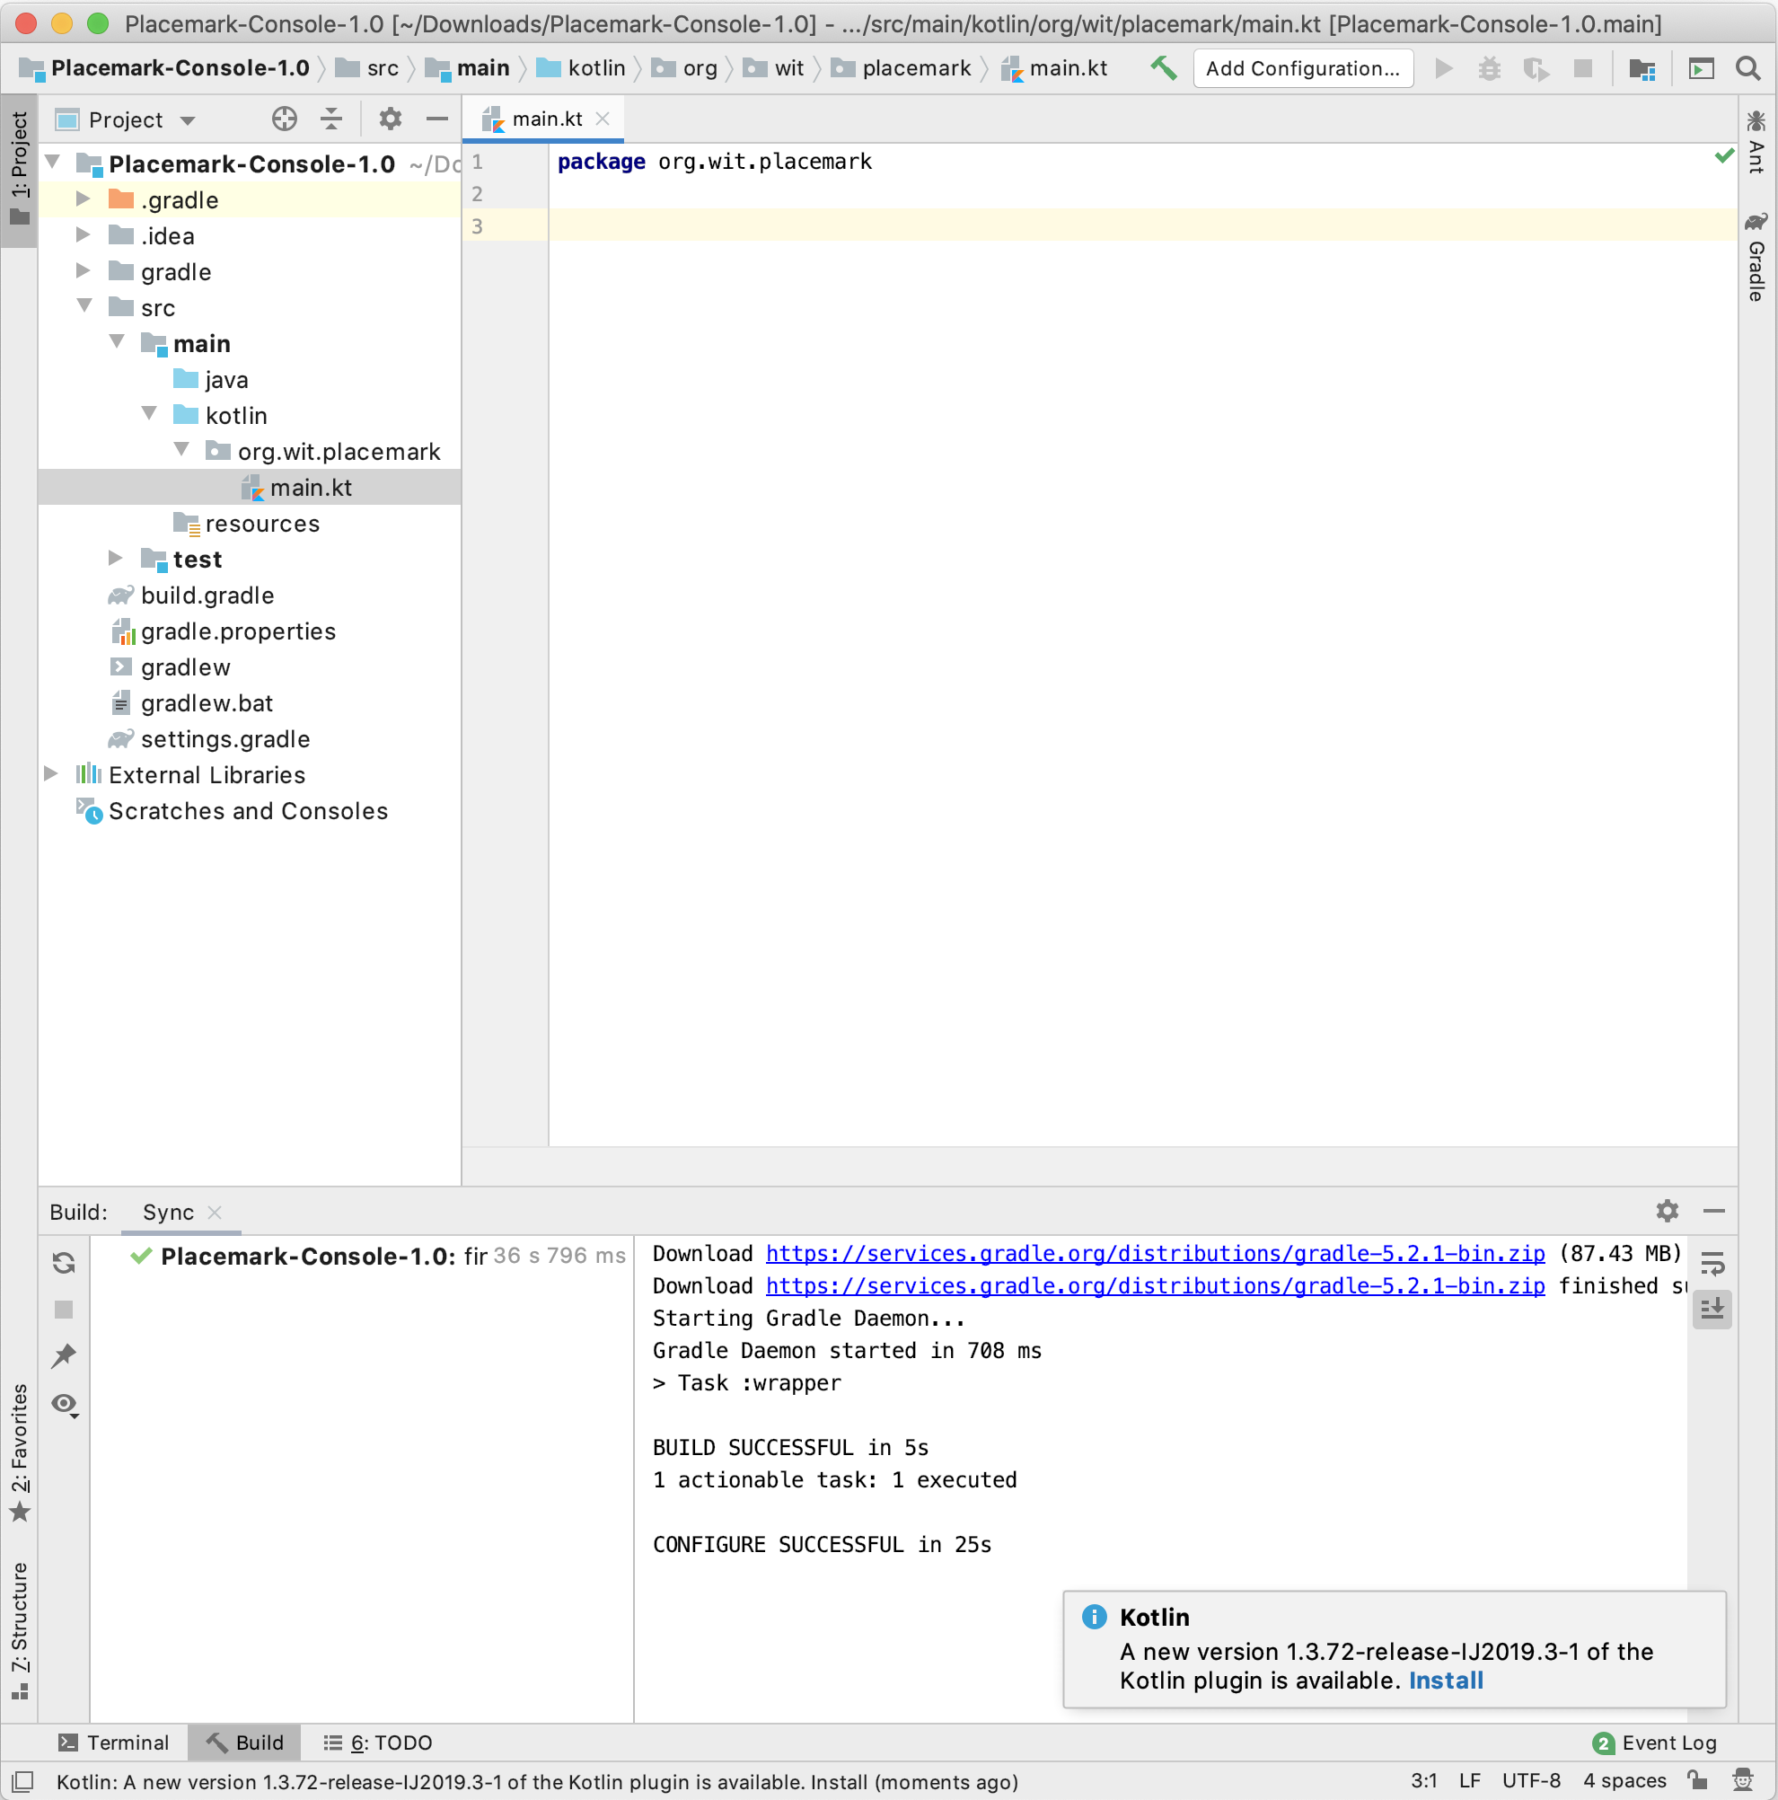
New Project using IntelliJ

Slide 16
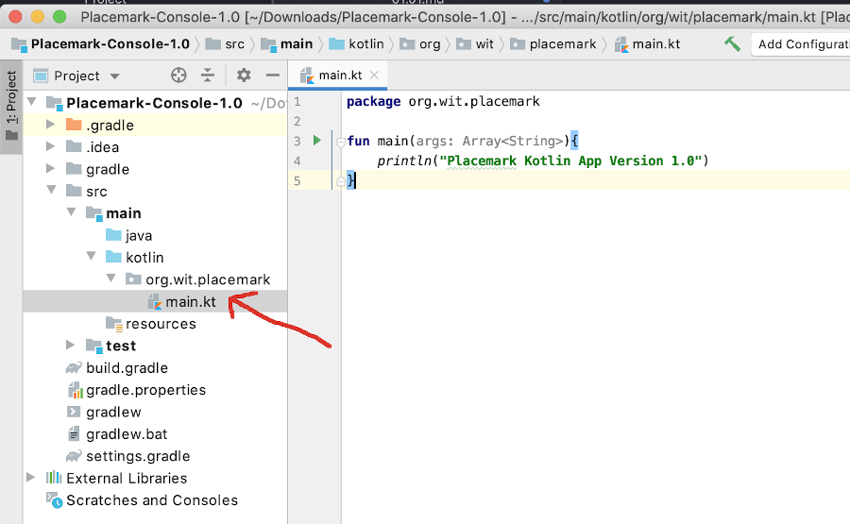
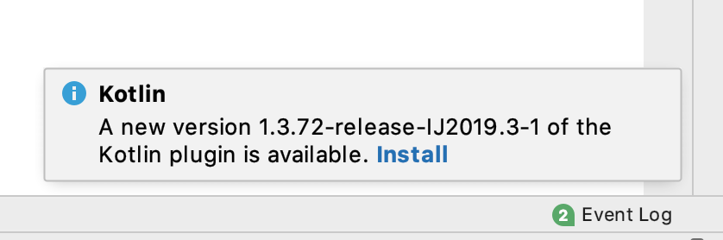
New Project using IntelliJ

Slide 17
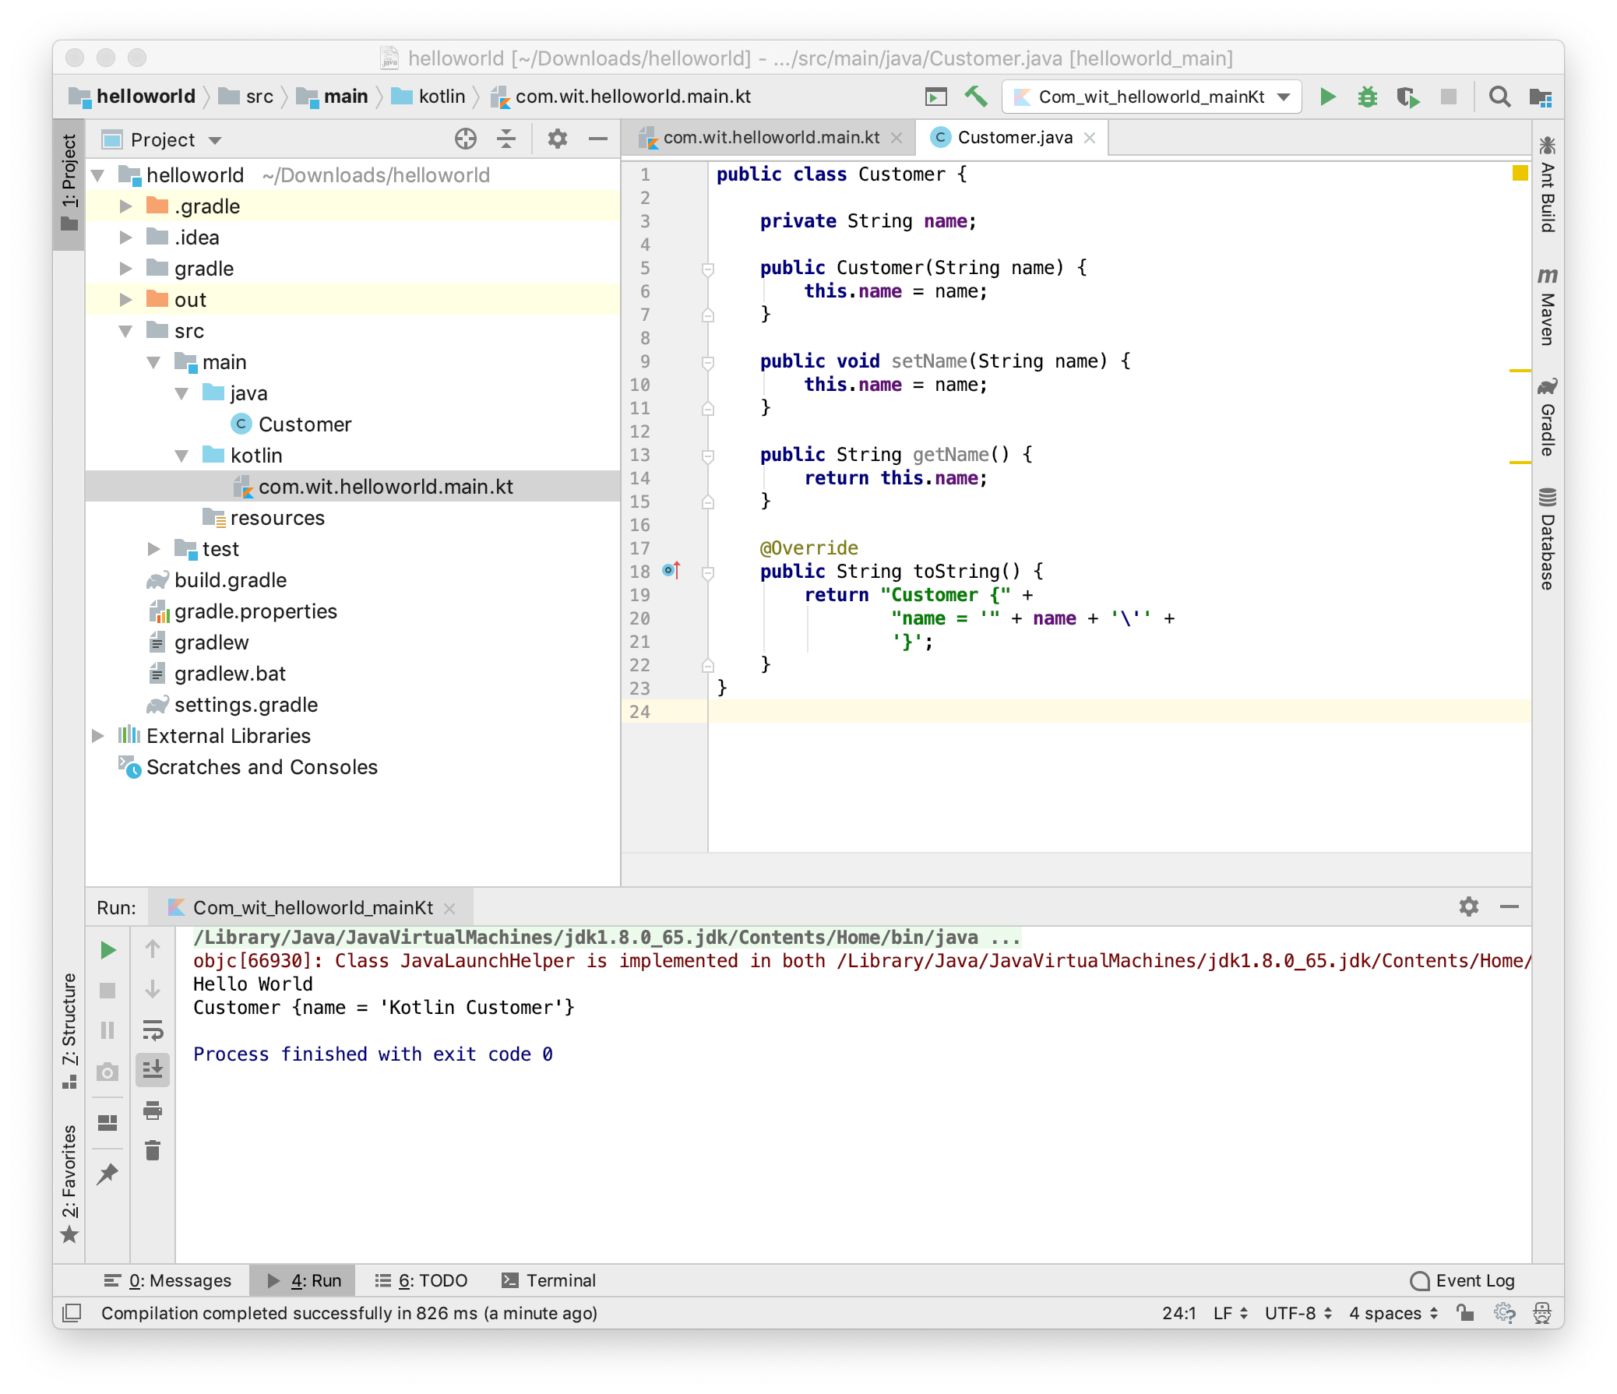
Interoperability

Slide 18
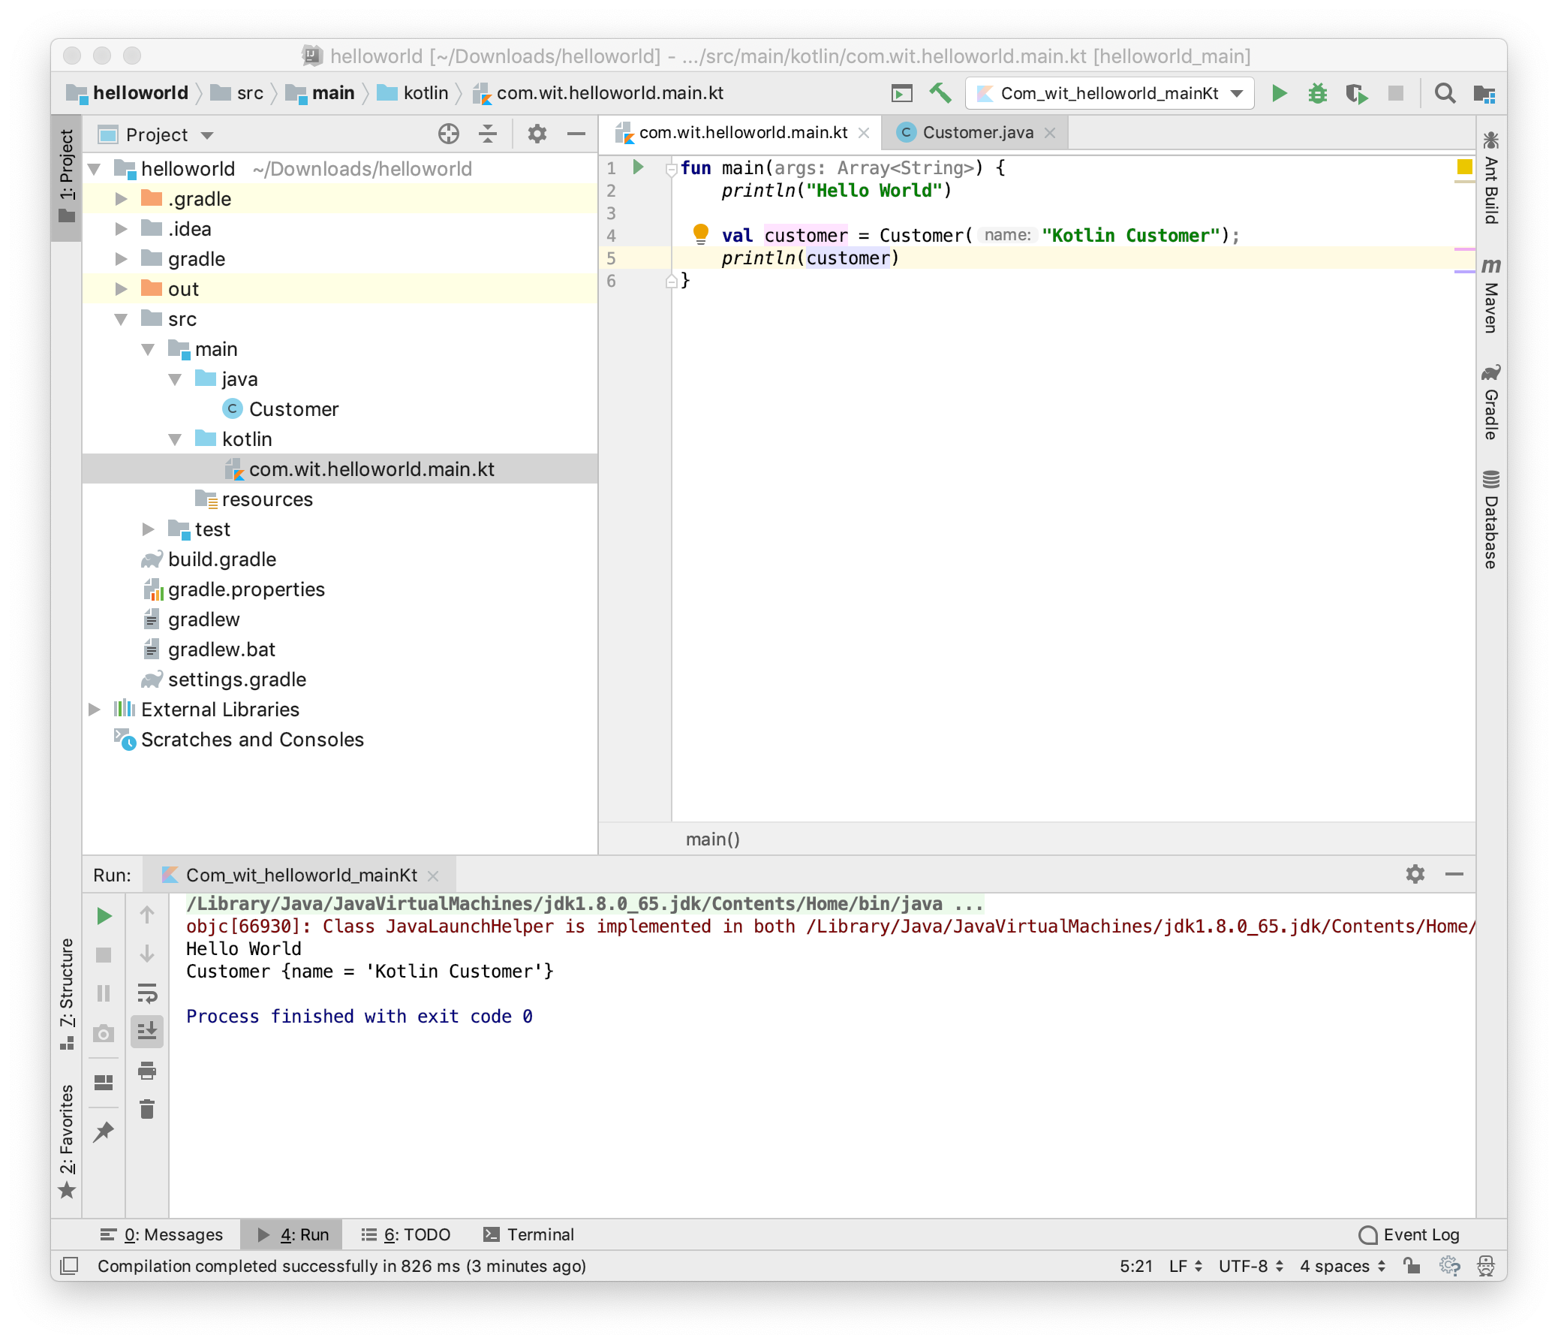
Interoperability

Slide 19
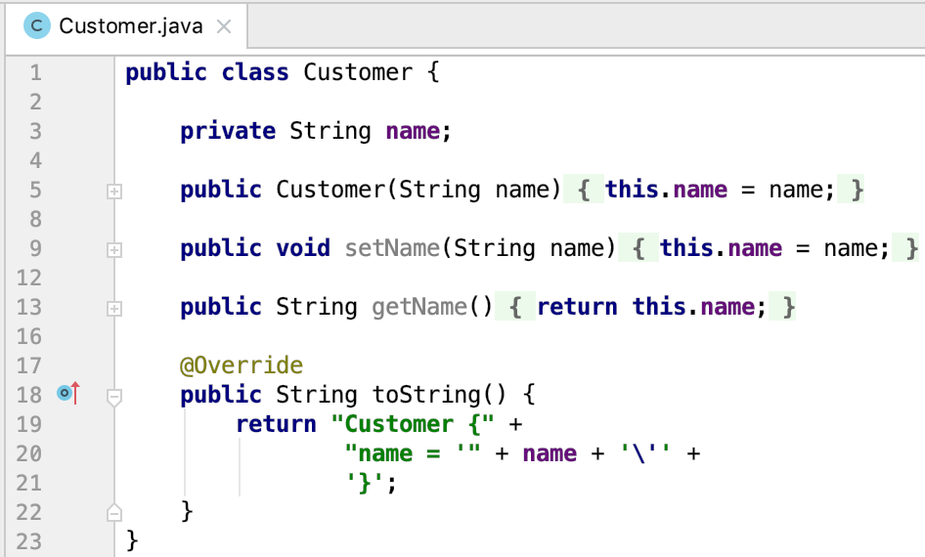
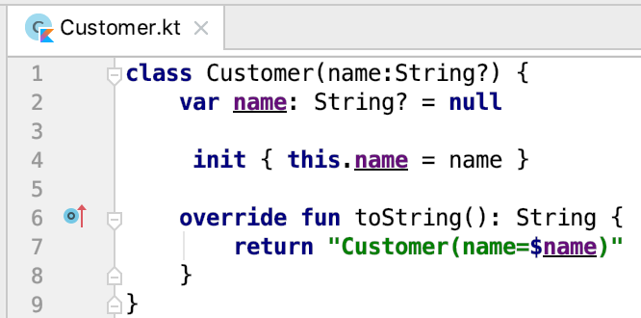
Interoperability – Java Vs Kotlin

Slide 20
Conclusion
Kotlin is low-cost: can be developed in the same IDE, in the same project as Java code
It’s on track to become one of the leading JVM languages
It’s best suited to work with IntelliJ idea;
It’s cool; allows bragging to friends about using the latest technologies ☺

Slide 21



